Slide 1
WEIGHTLIFTING FORM ANALYSER USING NEURAL NETWORKS
Team Members
Ayush Choudhary, Sidharth Chopra, Akshay Shingade

Slide 2
GOAL OF THE PROJECT
To create an application using neural networks that properly tracks a person while performing an exercise, so that we can get an insight into the different phases of the movement and the information can in turn be used to improve the performance of the lifts and stay injury free.
The application would take in a video of the person performing the exercise and provide an output that would consist of some different metrics that would tell the person about their performance and the areas where they can improve to further improve their performance.

Slide 3
MOTIVATION
To create an application that is a boon for people that can’t afford coaches or physical instructors.
Apart from that, athletes that come from very poor countries can benefit a lot from this application. Beginners/Intermediates will benefit a lot too from such an application as they’ll get to learn proper form and technique.
Last but not least, this can be a very useful tool for coaches as well and it will help a coach track the performance of their athletes.

Slide 4
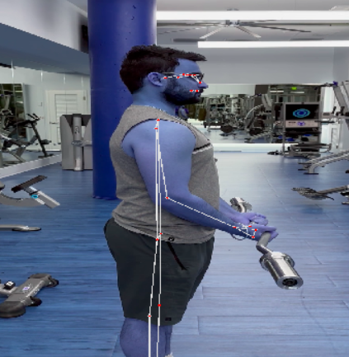
DATASET CREATION
We recorded videos of us and some other people that performed two exercises, namely, the dumbbell bicep curls and the triceps pulley pushdowns with proper correct form.
Videos were recorded from multiple angles, so that we can train our model from different angles, so that we can make it more accurate.
Pose estimation of the videos was then done using MediaPipe and we the calculated the angles that we required our model to train on. These angles were exported onto a csv and then we divided them as training and testing datasets.
Fig. 1- A frame from one of the bicep curl videos that we recorded.

Slide 5
DATA LABELING
Data labeling is the process of assigning a target or output value to each data point in a dataset, typically for use in machine learning algorithms. In our case, We are labeling correct posture data as 1 and incorrect posture data as 0
Correct posture data refers to data points that represent the correct positioning of the body while standing, sitting, or engaging in physical activity. This includes maintaining proper alignment of the spine, shoulders, hips, and other body parts. When a data point represents a correct posture, it is labeled with a value of 1.
On the other hand, incorrect posture data refers to data points that represent improper body positioning that can lead to strain, discomfort, or even injury. Examples of incorrect posture may include slouching, hunching the shoulders, or leaning forward excessively. When a data point represents an incorrect posture, it is labeled with a value of 0.

Slide 6
NEURAL NETWORK ARCHITECTURE
The architecture consists of three fully connected layers, followed by a single output layer
The first layer has 32 neurons and uses the ReLU activation function, which is a popular choice in deep learning due to its ability to effectively handle vanishing gradients. The layer also includes a L2 regularization term with a regularization strength of 0.01, which helps to prevent overfitting.
The second layer has 16 neurons and uses the ReLU activation function, along with the same L2 regularization term as the first layer.
The third layer has 8 neurons and again uses the ReLU activation function and L2 regularization term.
The final output layer has a single neuron, which uses the sigmoid activation function to produce a binary output, representing the probability of the input belonging to a particular class (in this case, the class is either 0 or 1).
Overall, this architecture can be used for binary classification tasks where the input data has two features. The use of regularization in the first three layers helps to prevent overfitting, while the sigmoid activation function in the output layer produces a probability value that can be thresholder to make a final classification decision.

Slide 7
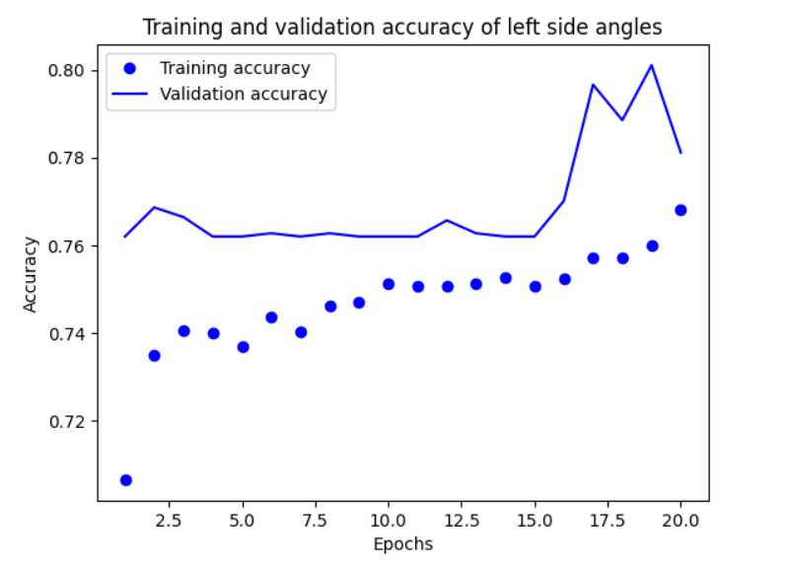
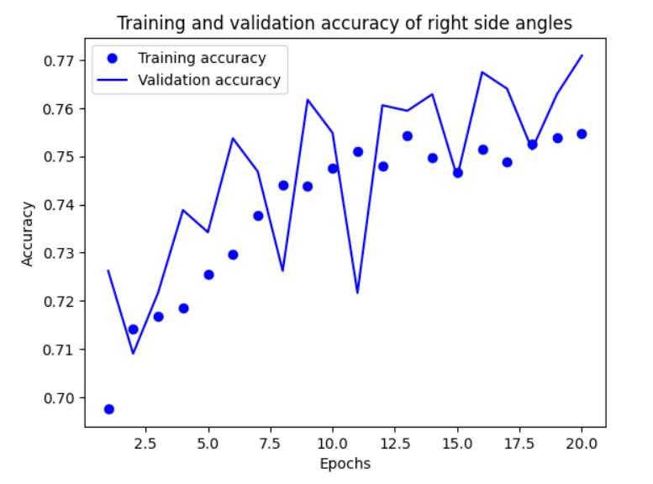
RESULTS AND ACCURACY
The two graphs below compare the training and the validation accuracy of the left-side and right-side angles of the bicep curl.

Slide 8
FUTURE SCOPE
We want to extend this application for all the exercises that are present out there. We have only made this application for the bicep curl and the triceps pushdowns currently, but we want to make it for all Olympic and compound movements.
We have only taken 3 views here, namely, the right side, the left side and the general view. We want to take videos from more perspectives, in order to have improved accuracy and better information about the z-axis.
Currently, our application takes in recorded videos as input and provides the user with the output. We want to improvise this by creating a system where the user would be able to get the same information live from their mobile camera.

Slide 9
CONCLUSION
The project aims to analyze weightlifting movements by extracting new statistics and insights that would be useful to coaches, athletes, performance scientists, and hobbyists.
The model will be trained on multiple videos to extract data such as posture, speed, and joint angles during different phases of a lift to provide comparison and improvement tips to users.
The tool developed through this project will not only benefit coaches and athletes in optimizing their performance but will also be useful for beginners and intermediate lifters to prevent injuries and improve their form.

Slide 10
Thank you

